Slide 1

Operating systems
Storage Management
Venkatesh Prasad
Department of Computer Science

Slide 2
Operating systems
Implementing File-Systems – Disk Space Allocation Methods
Venkatesh Prasad
Department of Computer Science
Notes:
To describe the details of implementing local file systems and directory structures
To describe the implementation of remote file systems
To discuss block allocation and free-block algorithms and trade-offs

Slide 3
OPERATING SYSTEMS
Slides Credits for all PPTs of this course
The slides/diagrams in this course are an adaptation, combination, and enhancement of material from the following resources and persons:
Slides of Operating System Concepts, Abraham Silberschatz, Peter Baer Galvin, Greg Gagne - 9th edition 2013 and some slides from 10th edition 2018
Some conceptual text and diagram from Operating Systems - Internals and Design Principles, William Stallings, 9th edition 2018
Some presentation transcripts from A. Frank – P. Weisberg
Some conceptual text from Operating Systems: Three Easy Pieces, Remzi Arpaci-Dusseau, Andrea Arpaci Dusseau

Slide 4
OPERATING SYSTEMS
Allocation Methods - Contiguous
An allocation method refers to how disk blocks are allocated for files:
Contiguous allocation – each file occupies set of contiguous blocks
Best performance in most cases
Simple – only starting location (block #) and length (number of blocks) are required
Supports both sequential and direct access
Problems include finding space for file, knowing file size, external fragmentation, need for compaction off-line (downtime) or on-line

Slide 5
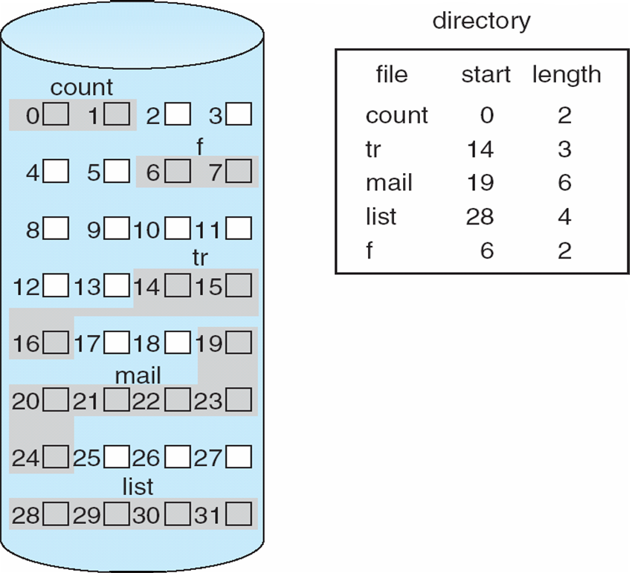
OPERATING SYSTEMS
Contiguous Allocation
Mapping from logical to physical
Q
LA/512
R
LA – Length of the area allocated for this file
Q = displacement into index table
Block to be accessed = Q + starting address
Displacement into block = R
Notes:
The directory entry for each file indicates the address of the starting block and the length of the area
allocated for this file

Slide 6
OPERATING SYSTEMS
Extent-Based Systems
Many newer file systems (i.e., Veritas File System) use a modified contiguous allocation scheme
Extent-based file systems allocate disk blocks in extents
An extent is a contiguous block of disks
Extents are allocated for file allocation
A file consists of one or more extents
Notes:
Veritas file system is a high-performance replacement for the std UNIX UFS and it uses extents to optimize performance

Slide 7
OPERATING SYSTEMS
Allocation Methods - Linked
Linked allocation – each file a linked list of blocks
File ends at null pointer
No external fragmentation
Each block contains pointer to next block
No compaction, external fragmentation
Free space management system called when new block needed
Improve efficiency by clustering blocks into groups but increases internal fragmentation
Reliability can be a problem
Locating a block can take many I/Os and disk seeks

Slide 8
OPERATING SYSTEMS
Allocation Methods – Linked (Cont.)
FAT (File Allocation Table) variation
Beginning of volume has table, indexed by block number
Much like a linked list, but faster on disk and cacheable
New block allocation simple

Slide 9
OPERATING SYSTEMS
Linked Allocation
Each file is a linked list of disk blocks: blocks may be scattered anywhere on the disk
block =
pointer
Mapping
Q
LA/511
R
Block to be accessed is the Qth block in the linked chain of blocks representing the file.

Slide 10
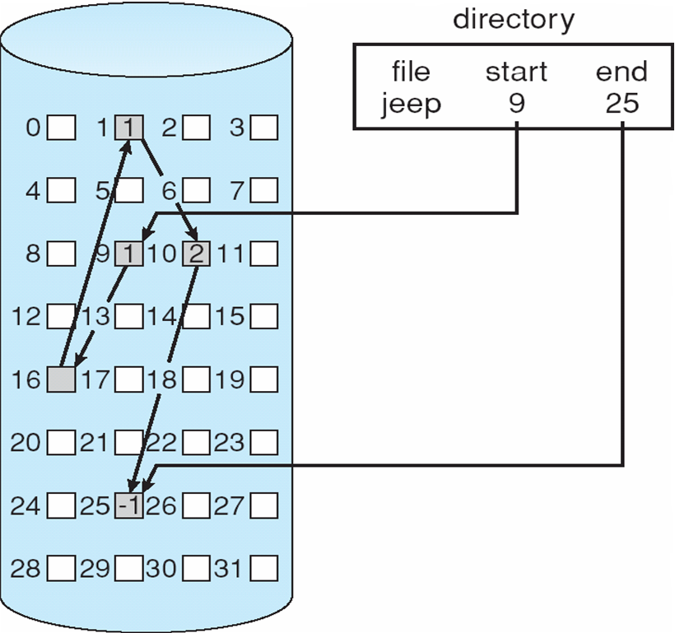
OPERATING SYSTEMS
Linked Allocation
Each block contains a pointer to the next block.
If each block is 512 bytes and a disk address (pointer) requires 4 bytes then the user sees blocks of 508 bytes (i.e. some disk space is wasted)
Collect blocks into multiples called clusters and allocate clusters rather than blocks

Slide 11
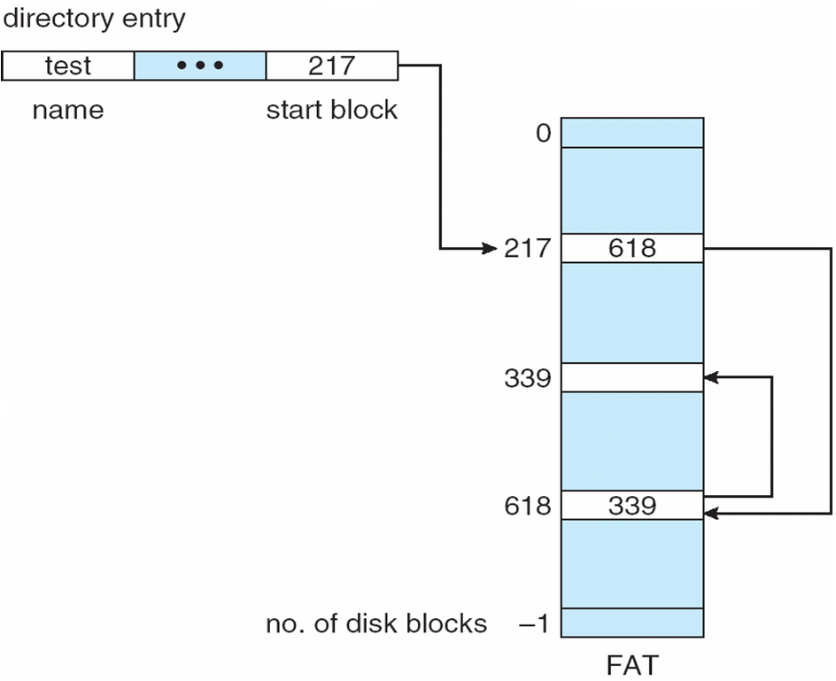
OPERATING SYSTEMS
File-Allocation Table (variation on linked allocation)
Unused block is indicated by a table value of 0
To allocate a new block to a file, find the first 0-valued table entry and replace the previous EOF value with the address of the new block.
Then replace 0 with EOF value

Slide 12
OPERATING SYSTEMS
Allocation Methods - Indexed
Indexed allocation
Each file has its own index block(s) of pointers to its data blocks
Logical view

Slide 13
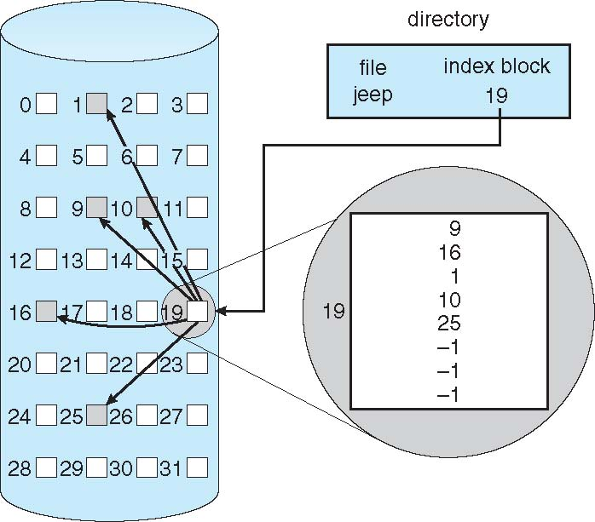
OPERATING SYSTEMS
Example of Indexed Allocation
In this scheme, a special block known as the Index block contains the pointers to all the blocks occupied by a file.
Each file has its own index block. The ith entry in the index block contains the disk address of the ith file block.
The directory entry contains the address of the index block as shown in the figure.

Slide 14
OPERATING SYSTEMS
Allocation Methods – Indexed (Cont.)
Advantages:
This supports direct access to the blocks occupied by the file and therefore provides fast access to the file blocks.
It overcomes the problem of external fragmentation.
Disadvantages:
The pointer overhead for indexed allocation is greater than linked allocation.
For very small files, say files that expand only 2-3 blocks, the indexed allocation would keep one entire block (index block) for the pointers which is inefficient in terms of memory utilization. (Note: In linked allocation we lose the space of only 1 pointer per block.)

Slide 15
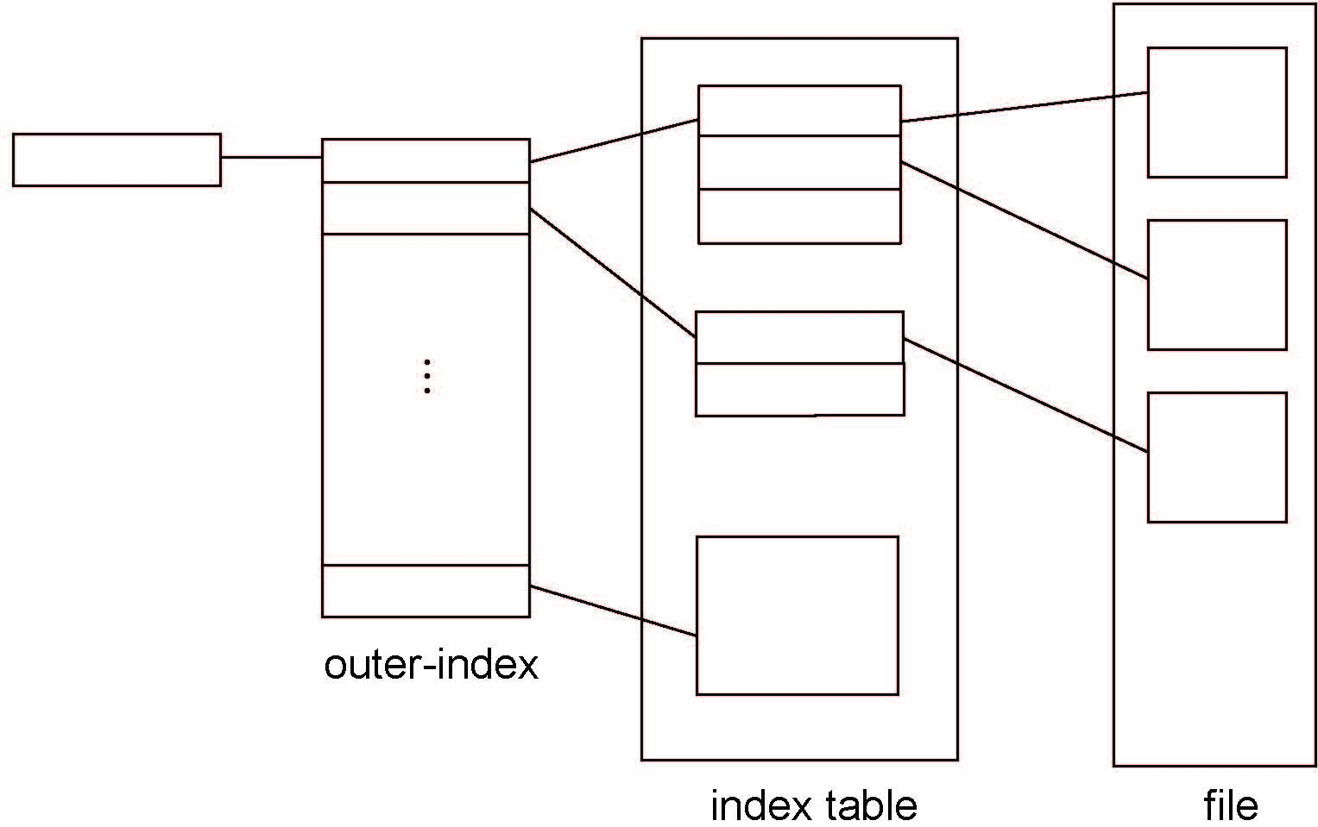
OPERATING SYSTEMS
Indexed Allocation – Mapping (Cont.)
For files that are very large, single index block may not be able to hold all the pointers.
Other Schemes such as Linked scheme, Multilevel index and Combined Scheme are used.
Notes:
Linked scheme: This scheme links two or more index blocks together for holding the pointers. Every index block would
then contain a pointer or the address to the next index block.
Multilevel index: In this policy, a first level index block is used to point to the second level index blocks which in turn
points to the disk blocks occupied by the file. This can be extended to 3 or more levels depending on the maximum file size.

Slide 16
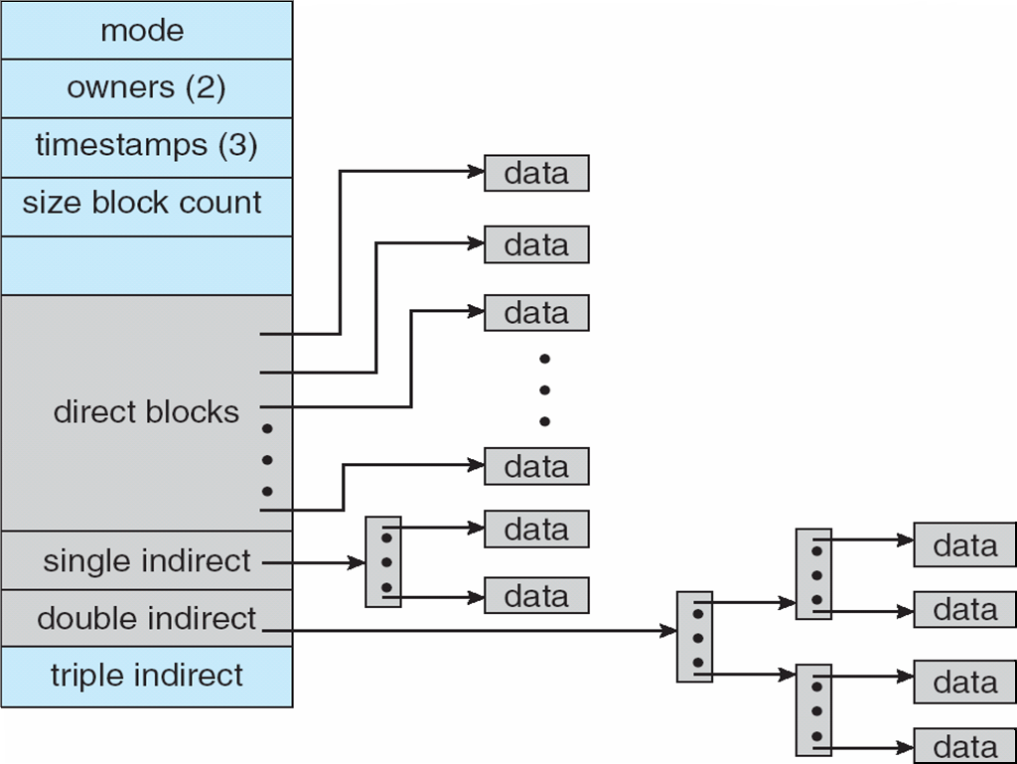
OPERATING SYSTEMS
Combined Scheme: UNIX UFS
4K bytes per block, 32-bit addresses
More index blocks than can be addressed with 32-bit file pointer
Notes:
In this scheme, a special block called the Inode (information Node) contains all the information about the file such as the name, size, authority, etc and the remaining space of Inode is used to store the Disk Block addresses which contain the actual file as shown in the figure.
The first few of these pointers in Inode point to the direct blocks i.e the pointers contain the addresses of the disk blocks that
contain data of the file. The next few pointers point to indirect blocks. Indirect blocks may be single indirect, double indirect or triple indirect. Single Indirect block is the disk block that does not contain the file data but the disk address of the blocks that contain the file data. Similarly, double indirect blocks do not contain the file data but the disk address of the blocks that contain the address of the blocks containing the file data.

Slide 17
OPERATING SYSTEMS
Performance
Best method depends on file access type
Contiguous great for sequential and random
Linked good for sequential, not random
Declare access type at creation -> select either contiguous or linked
Indexed more complex
Single block access could require 2 index block reads then data block read
Clustering can help improve throughput, reduce CPU overhead

Slide 18

THANK YOU
Venkatesh Prasad
Department of Computer Science Engineering
venkateshprasad@pes.edu

